Slide 1
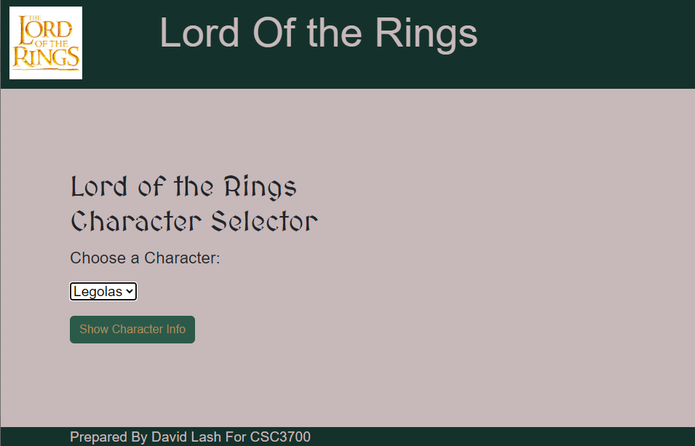
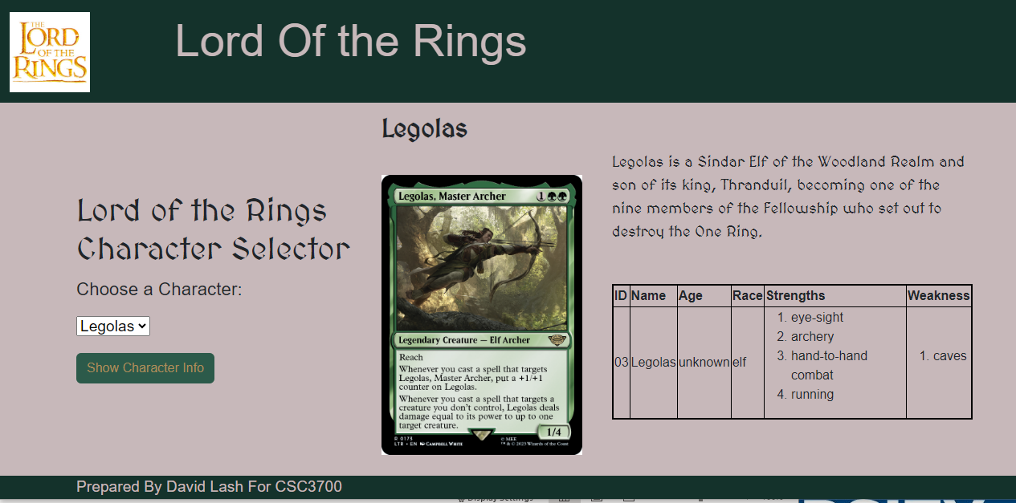
Lord Of The Rings Cards – html/css/js
Build this responsive site using css, html, bootstrap and JS

Slide 2
Overall Style Requirements
1.1 include this top area with this image and title and the text is large …
a. note title is 100px away from image
b. there is space around this logo
c. The complete color scheme come from here: https://www.colorhunter.com/palette/1830948
d. Use the google font MedievalSharp https://www.w3schools.com/howto/tryit.asp?font=MedievalSharp
1.2 All items from this drop down SHOULD NOT BE hard-coded but instead come from the JSON data onLoad
A. The right hand side will be initially blank until the user hits submit of the botton
1.4 There is a footer here that shows your name (not mine)
1.5 The entire layout must be built using bootstrap css library

Slide 3
R2 – Load data dynamically
a. When user selects a character and presses button … load the information here
b. Make sure Weakness and Strengths is formatted into a numbered list
c. and image is properly and consistently scaled
d. The description is here and the character name is a title bold and large
e. Include this information as a table

Slide 4
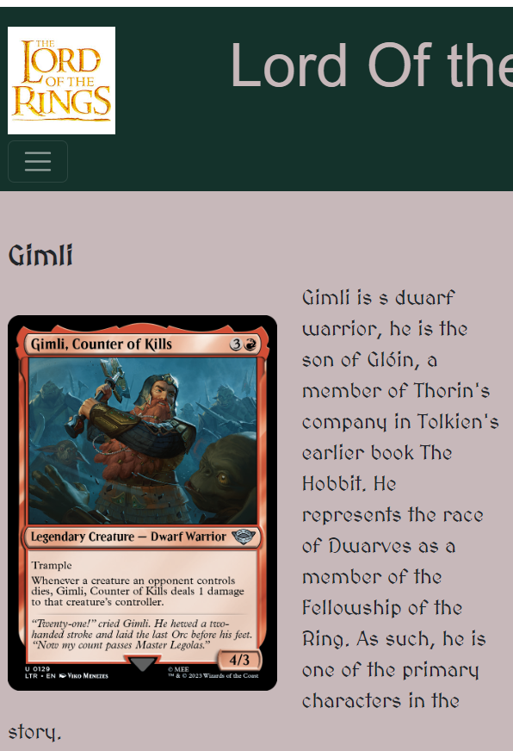
R3- Make sure page is responsive
Your page should properly stack when viewed as mobile
Note images and text should scale properly
E.g., In this case the image should be smaller AND this title should be smaller
You have to tighten up this gap area
This hamburger should not display since we don’t have any nav items

Slide 5
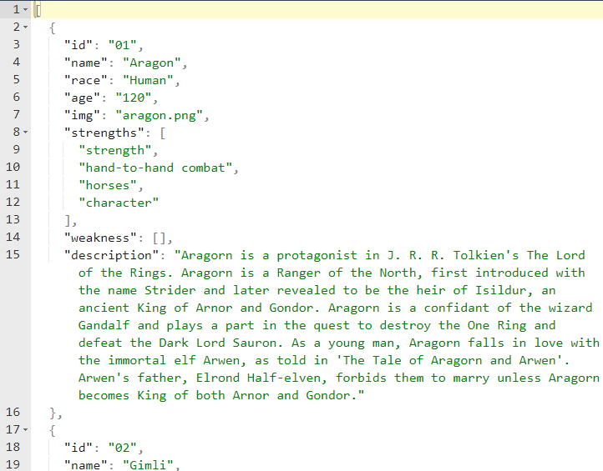
Utilize the following data feed to create the left drop down and right side results
Use this URL to generate the options for the select drop down
AND the results on the right
http://45.55.136.114/~dlash/CSC3700/lotrV4.php
The JSON format in https://jsonformatter.org/json-pretty-print
Provides all the data you need to create the display
The image to load from your site
Note: not all characters have strengths and weakness.

Slide 6
What to hand in …
Your source code zipped together in a single package that includes:
- All of your html, imgs, css and javascript code
A SINGLE WORD DOCUMENT with Screen shots showing the output of the following clearly labeled
1. Aragon selected
2. Boromir Selected
3. Legolos selected

Slide 7
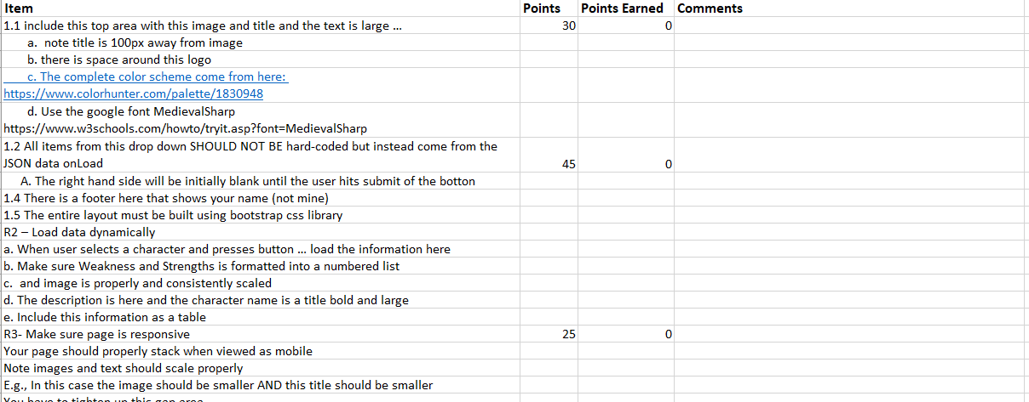
Assignment Rubric

